Slide 1
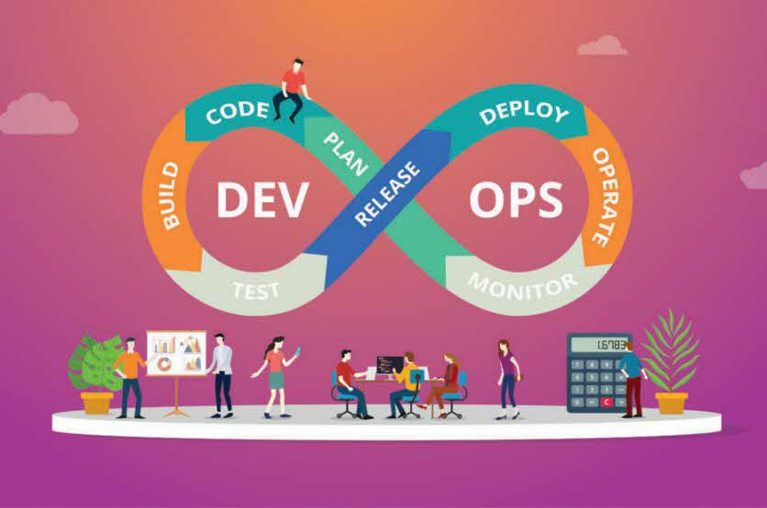
DevOps_Geeks!!
Squad 11
Members
Subhash Kumar Jha (394176) - 1
Deepak Rohan Sekar (1327132)- 2
Prateek Gupta (552803) - 3
Vikram Varoo (1744720) - 4
Sandeep Loya (724122) - 5
Roshan Chowdhury(592019) - 6

Slide 2
What was done as part of case Study​
We used Scripted Jenkins Pipeline.
We Created VM’s (Deploy/Test/Prod) AWS Cloudformation (YML) file.
We are using Ansible Playbook to deploy docker image to K8s cluster.
We Built Pipeline using Jenkins File(Groovy).
We Integrated GIT, Slack, Jira​, Jfrog, Docker, ansible, Blazemeter, SonarQube & K8s with Jenkins.
Containerize the app – Compile --> Package --> Sonarqube Analysis --> Jfrog Artifactory Push -->
Deploy To test Server --> Blazemeter Performance test --> Docker Push -->
Deploy to QA K8s Cluster --> Selenium Automation Testing --> Deploy to Prod K8s Cluster

Slide 3
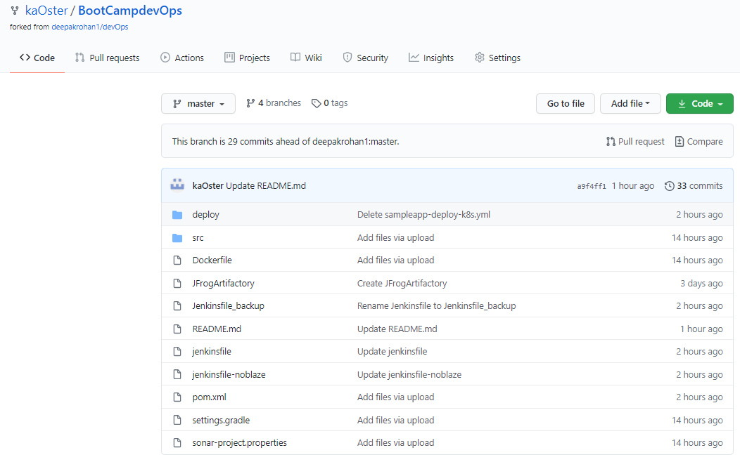
CI /CD Pipeline
Github repo - https://github.com/kaOster/BootCampdevOps.git

Slide 4
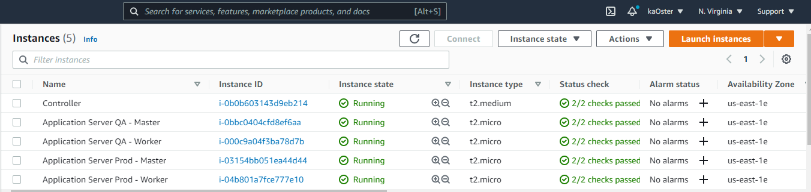
CI /CD Pipeline (Contd..)
AWS Instances

Slide 5
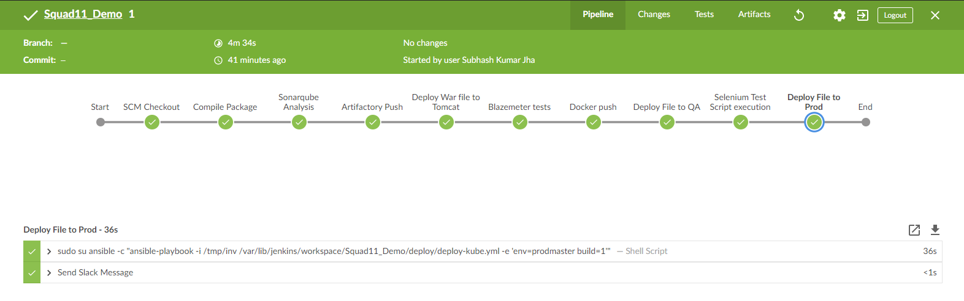
CI /CD Pipeline (Contd..)
Jenkins CI-CD pipeline view in Blue Ocean

Slide 6
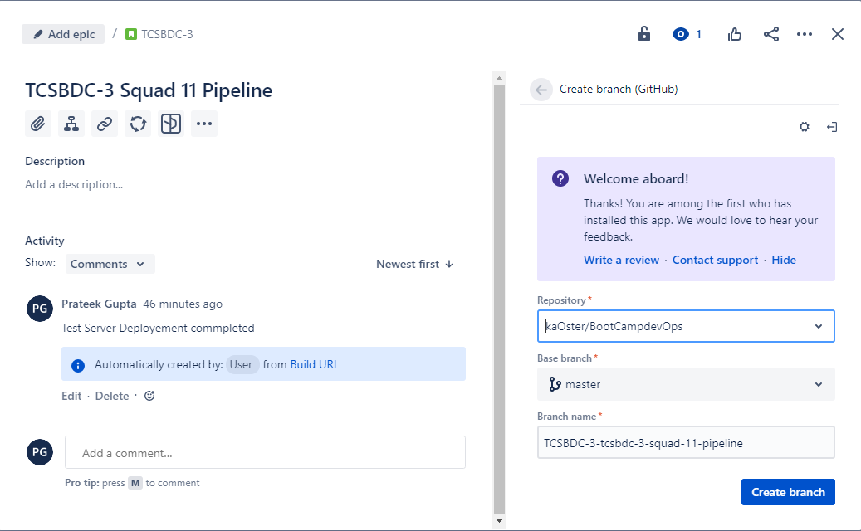
CI /CD Pipeline (Contd..)
Jira integration

Slide 7
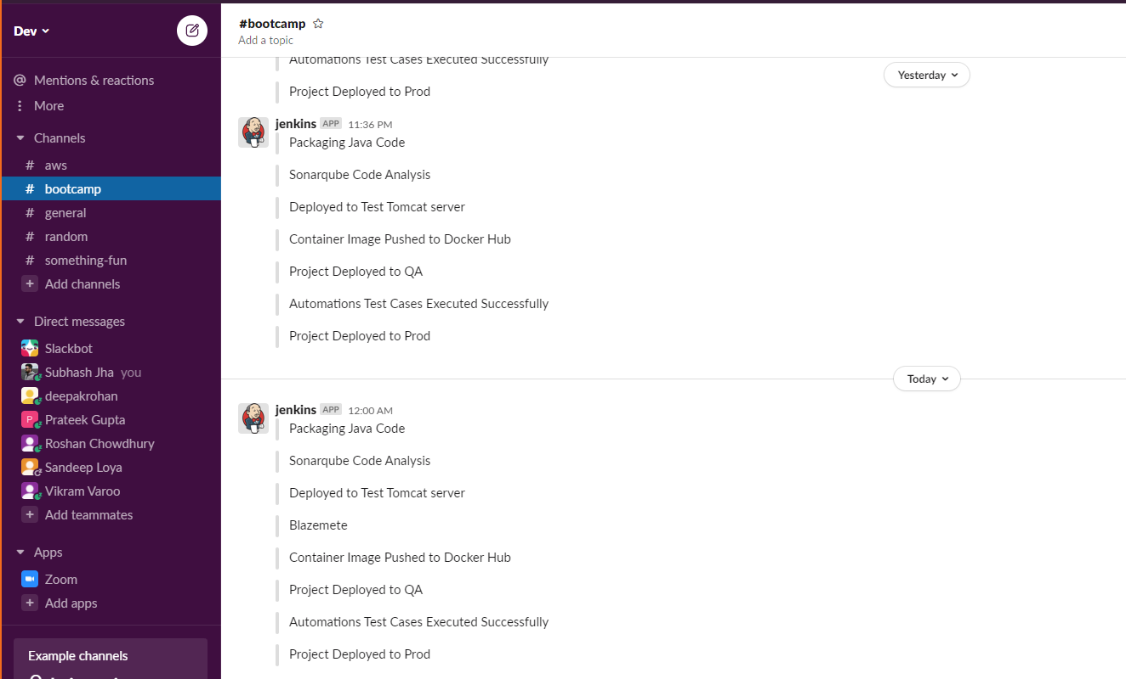
CI /CD Pipeline (Contd..)
Slack Integration

Slide 8
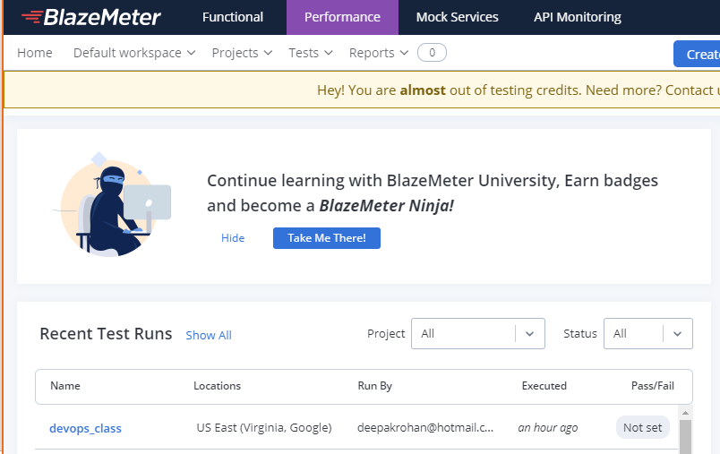
CI /CD Pipeline (Contd..)
BlazeMeter Integration

Slide 9
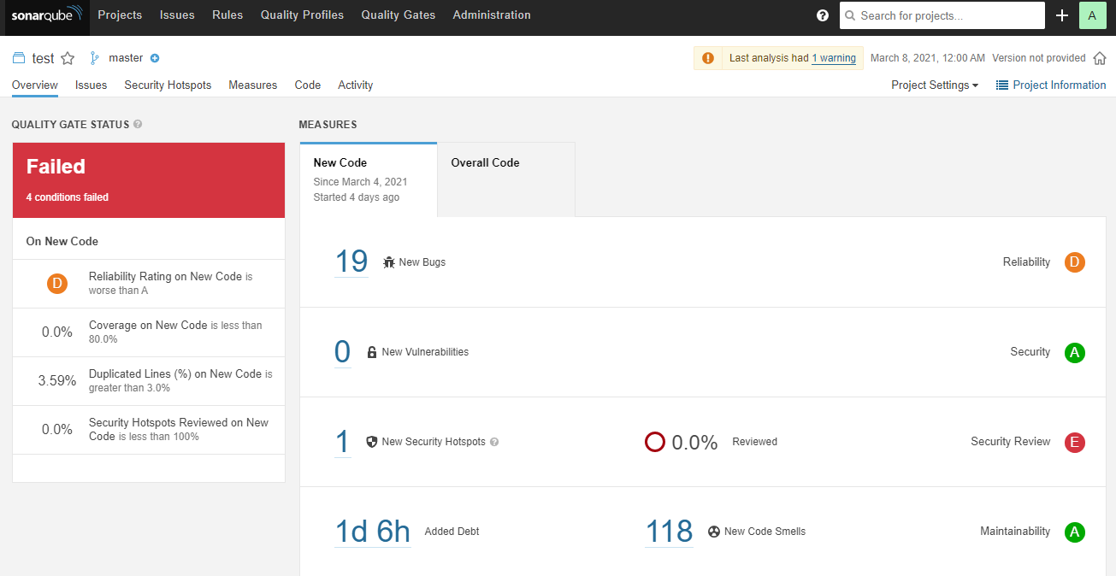
CI /CD Pipeline (Contd..)
SonarQube Integration

Slide 10
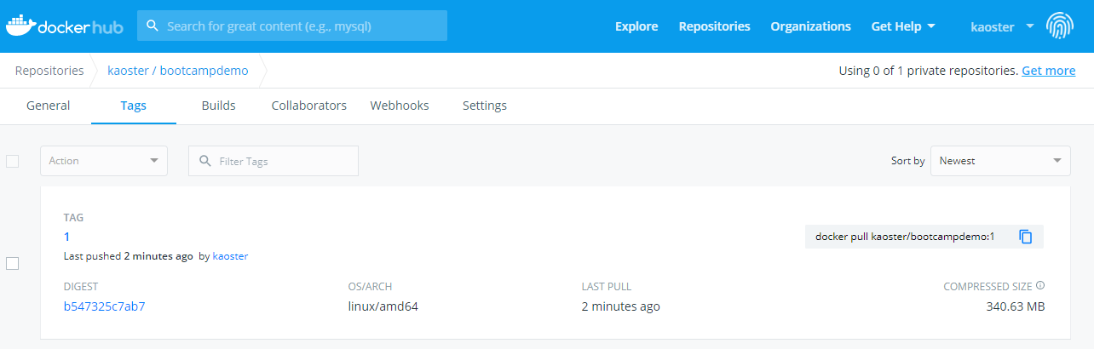
CI /CD Pipeline (Contd..)
Docker Hub

Slide 11
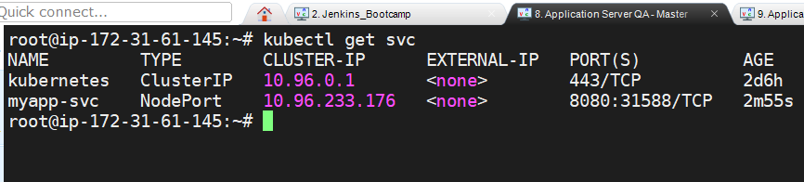
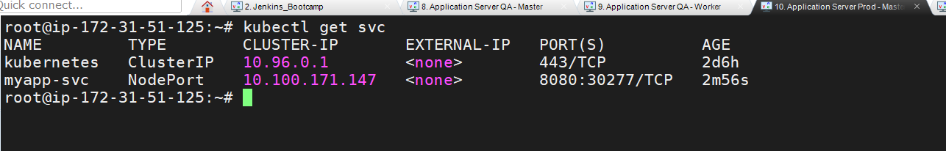
CI /CD Pipeline (Contd..)
QA/Prod K8s Cluster Deployment

Slide 12
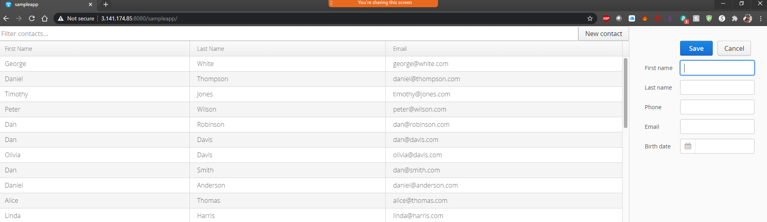
CI /CD Pipeline (Contd..)
Deployed Webpage (QA)

Slide 13
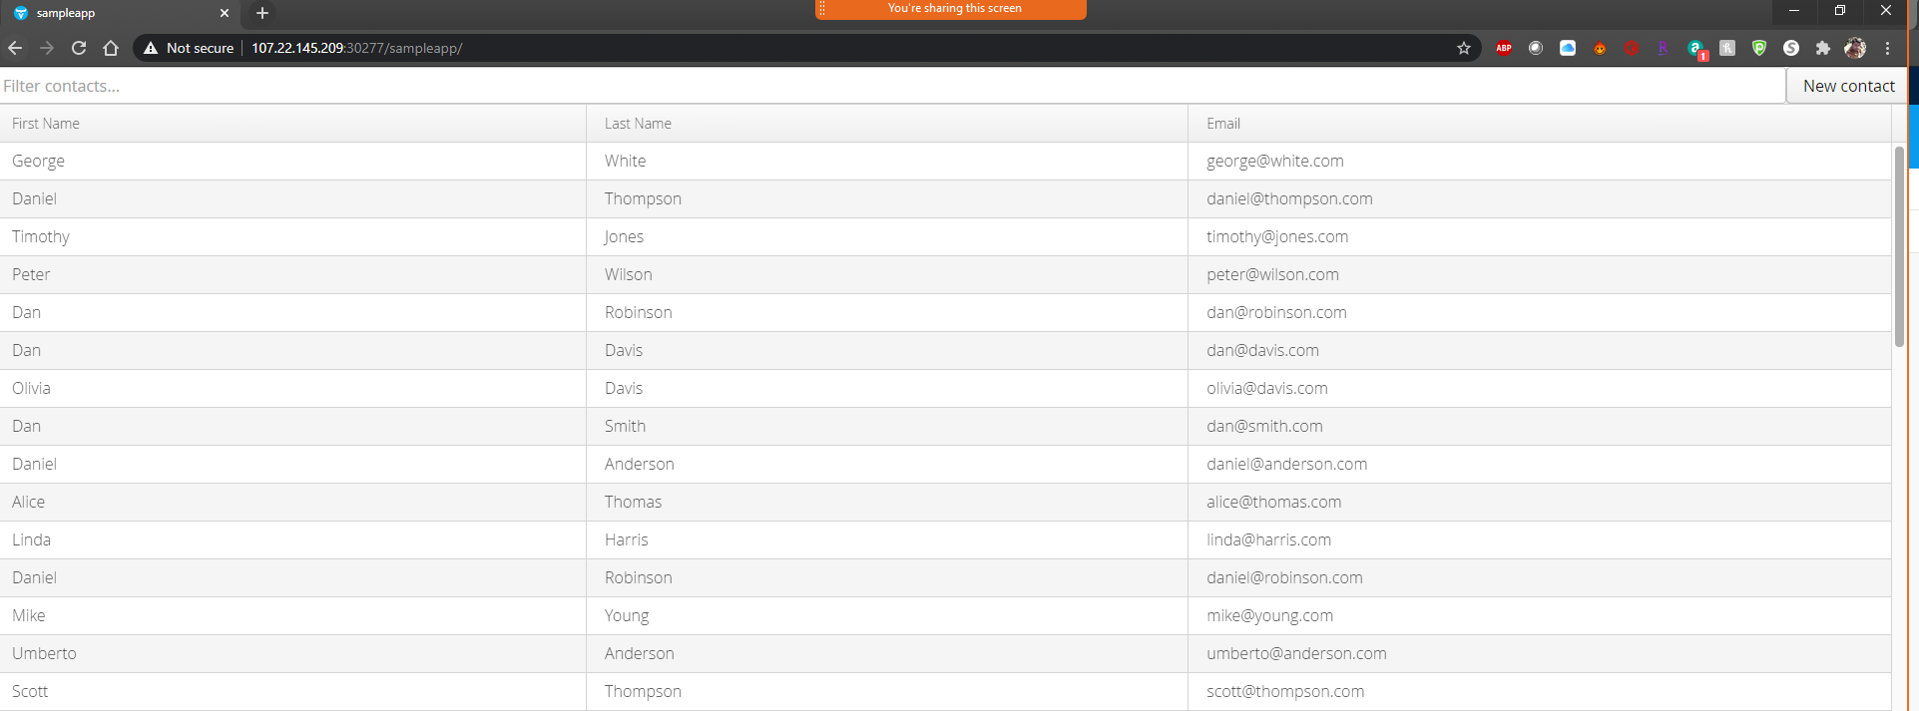
CI /CD Pipeline (Contd..)
Deployed Webpage (PROD)

Slide 14








Links
Jira https://tcsdevopsbootcamp03.atlassian.net/jira/software/projects/TCSBDC/boards/1
GitHub https://github.com/kaOster/BootCampdevOps/blob/master/jenkinsfile (Jenkins file link)
Jenkins http://18.207.233.199:8080/ (User: Jenkins | Pass: Jenkins)
SonarQube http://18.223.181.66:9000/projects (User: admin | Pass: sonar)
Slack https://dev-lfz3685.slack.com/archives/C01QMBLJYE8
Jfrog https://devopsartifactoryroshan.jfrog.io/
Blazemeter https://a.blazemeter.com/app/#/accounts/747885/workspaces/756008/dashboard
TEST server http://3.141.174.85:8080/sampleapp/ (Tomcat Server)
QA Server http://34.234.193.23:31588/sampleapp/ (K8s Cluster)
Prod Server http://107.22.145.209:30277/sampleapp/ (K8s Cluster)

Slide 15
